Slide 1
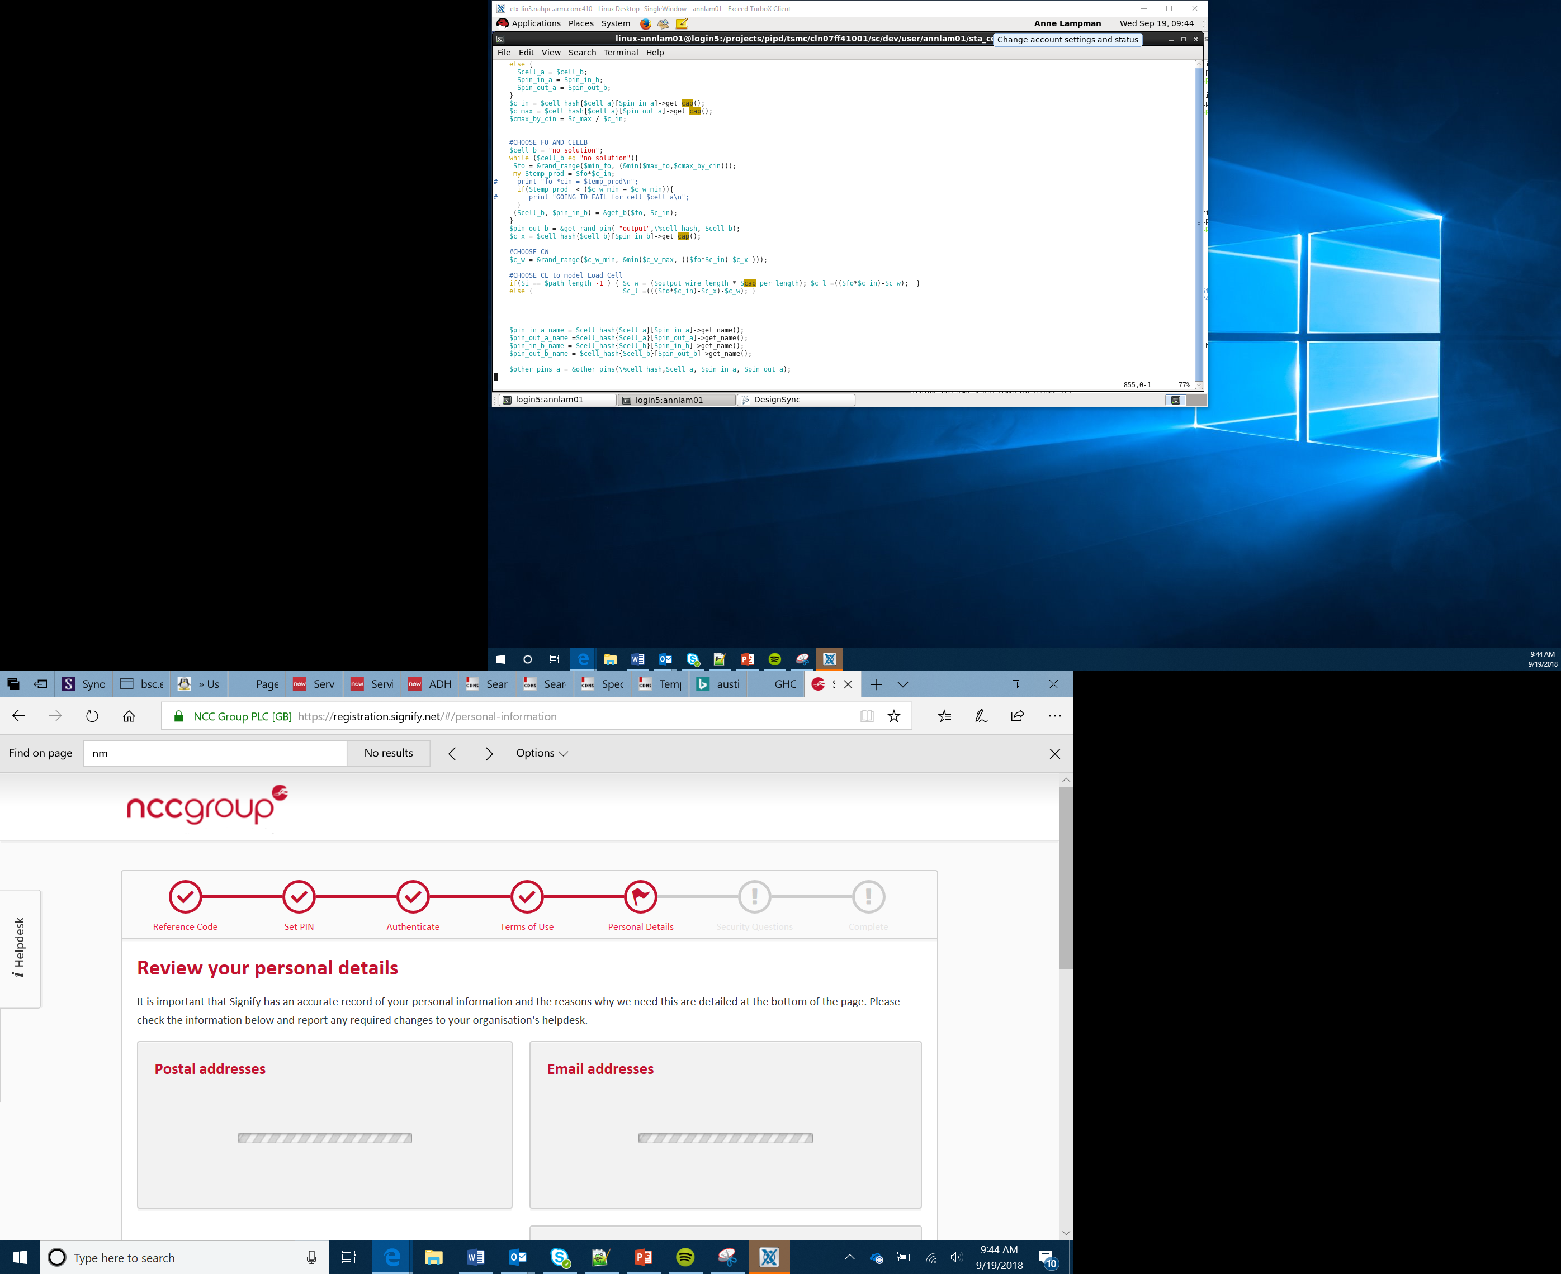

Making the micro:bit speak
Lesson 8

Slide 2
What the Lesson Will Cover
Recap how a speaker works and what modules are
Know how the micro:bit produces speech
Program the micro:bit to speak
Edit the quality of the speech
Create a musical performance

Slide 3
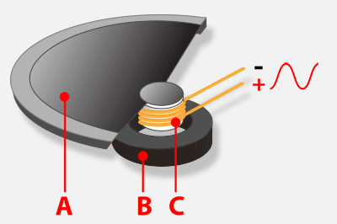
How a Speaker Works Recap
A speaker produces sound by moving the air around it to create a sound
The magnet B is controlled by the current C which is sent along the positive wire
The magnet can either push or pull the cone A, which moves the air around it
Your ears hear these changes and interpret them as sounds, noise, talking or music
Notes:
Show a speaker if you have access to one, you could play some music so the Learners can see the cone moving.

Slide 4
Modules Recap
This program uses a Module – these are libraries of code that offer additional functions to the Python programming language.
This lesson will use the speech module
Do you remember how to use a module?
from microbit import * import speech speech.say("Hello, World")
Notes:
Ask Learners if they remember what a module is?
Can name any other modules, import time, import random etc.
Learners complete first activity and set up speech.

Slide 5
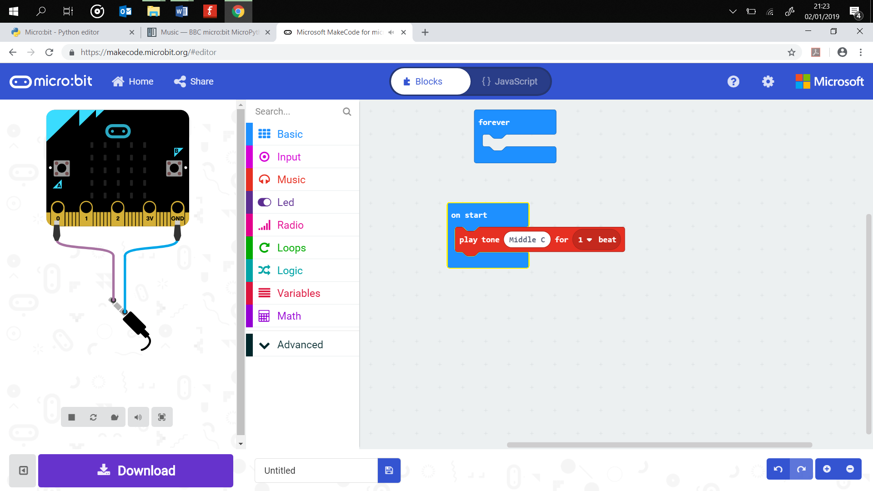
Speaker Set Up
The micro:bit can produce music
But it needs a speaker or headphones. The V2 microbit has a built in speaker.
If you are using a V1 microbit use the crocodile clips to wire up as shown in the diagram
The wire on the far left sends the signals to the jack on your speaker cable and controls the cone
Notes:
Set up the speaker

Slide 6
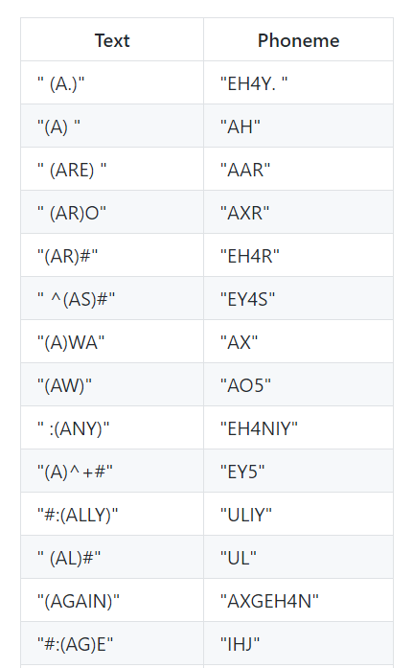
How Does the micro:bit Produce Speech?
The micro:bit uses an old text to speech (TTS) program called SAM (Software Automated Mouth)
This was originally released in 1982 for the Commodore 64
Sebastian Macke is responsible for bringing it to the micro:bit
The program uses a Text to Phoneme converter to convert the text into the sounds that it makes, for example Feet is FEE EE TU
Then another program, Phoneme to Speech, converts them into audible sounds
Notes:
Explain how,

Slide 7
Making the Speech Sound Better
There are four areas that can be adjusted to make the speech sound different:
Pitch – how high or low the voice sounds (0 = high, 255 = low)
Speed – how quickly the device talks (0 = to fast, 255 = very slow)
Mouth – how well the words are enunciated (0 = ventriloquist, 255 = Shakespearean actor!)
Throat – how relaxed or tense the voice is (0 = very tense, 255 = calm)
Notes:
Explain each of the following, you could ask the Learners to demonstrate what the speech will sound like, speaking high or low, with a tense voice etc.

Slide 8
Try some of these:
Description | Speed | Pitch | Throat | Mouth
Elf | 72 | 64 | 110 | 160
Little Robot | 92 | 60 | 190 | 190
Stuffy Guy | 82 | 72 | 110 | 105
Little Old Lady | 82 | 32 | 145 | 145
Extra-terrestrial | 100 | 64 | 150 | 200
SAM | 72 | 64 | 128 | 128

Slide 9
Making the Speech Sound Better
Adapt the program to make the sound better:
from microbit import *
import speech
speech.say("How are you?", speed=110, pitch=100, throat=100, mouth=200)
Notes:
Learners try out different speech settings

Slide 10
The micro:bit Performance
Complete the activities:
Write a program so that your micro:bit reads out your favourite poem or a short story
Create a song lyric quiz where your micro:bit reads out a single line from a song. Other learners then have a few seconds to guess what it is and write it down. You can automate the quiz by using the sleep() function. Use the example code in the Activity Sheet as a starting point
Use the musical notes from Lesson 6 and combine them with the speech to perform a song. Use the example code in the Activity Sheet as a starting point
Notes:
Learners complete the second part of the Activity Sheet.
Learners can perform and judge or try out the programs as part of the lesson.

Slide 11
Success Criteria
The musical performance must have:
Music
Speech

Slide 12
Pro-tip
Try and make use of the rest code as this adds pauses to your melody and will improve the overall feel of the music that you have created

